Slide 1
Spam Message Detector Model
Project Supervisor:
Project Members:

Slide 2
Introduction
This is usually called spam detection and can be a Binary classification problem. The reason for doing this is often straightforward by recognizing spontaneous and unwanted emails, ready to prevent spam messages from reaching the user's inbox, and subsequently speed up client engagement.
Spam detection can be a problem with machine learning. This means that you have to show your machine learning with a set of spam and ham message cases and let it discover significant propositions that isolated two different categories. Most e-mail vendors have their claims on huge information sets of tagged e-mails. Every time you mark an email as spam in your Gmail account, you give Google the opportunity to prepare information for its machine learning calculations.

Slide 3
Methods
We flagged the messages for a spam detection issue, but we're not sure how many unused incoming messages there are. We will require a show that can tell us the probability that the message is spam or not spam. 0 Acceptance in this case shows — a negative class (no appearance of spam) and 1 shows — a positive class (close to spam), We will use the logistic regression model.
from sklearn.linear_model import LogisticRegression
from sklearn.model_selection import train_test_split as tts
x_train, x_test, y_train, y_test = tts(x, y, test_size = 0.3, random_state = 42)
model = LogisticRegression()
model.fit(x_train, y_train)

Slide 4
Methods
SVM can be a supervised machine learning Algorithms that can be used for both classification and Regression. In any case, it is mostly used in classification matters. As part of the SVM computation, we plot each data item as a point in an n-dimensional space where n can be the number of highlights you have, with the valuation of each one being the valuation of a particular arrangement. At this point, we perform the classification by finding the hyper-plane that separates the two classes exceptionally well.

Slide 5
Methods
Using Bayes' Run the show, we need to find out how likely an email is spam because it contains certain words. We do this by finding the probability that each word in an email is spam, and then duplicating those probabilities together to force a bulk spam metric to be used in the classification.

Slide 6
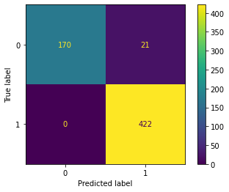
Result
First we define the model then fit the train data through Logisticregression. This phase is called training your model. Once the training phase is complete, we are able to use the testing part and predict what will happen. In order to verify the accuracy of our demonstrations, we are able to use the accuracy score metric. This metric compares the expected arrival to what actually happens. After Running the code, we got 0.9846153846153847 Score. We will show the predicated label on Confusion Matrix
Confusion_Matrix

Slide 7
Result
Secondly we define the model then fit the train data through SVM. This phase is called training your model. Once the training phase is complete, we are able to use the testing part and predict what will happen. After Running the code, we got 0.9853181076672104 Score

Slide 8
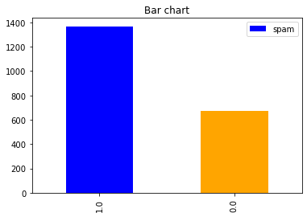
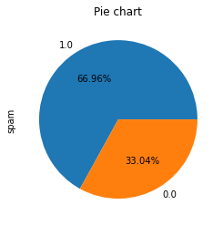
Result
finally we define the model then fit the train data through Bayes'. This phase is called training your model. Once the training phase is complete, we are able to use the testing part and predict what will happen. After Running the code, we got

Slide 9
Conclusion
As we have seen, we used the information already collected to prepare the show and assumed a category for modern upcoming emails. This demonstrates the importance of labeling information in the right way. One flop can make your machine dumb like in your gmail or any other email account once you get emails and you think it might be spam but you choose to ignore it, it might be another time once you see that email, you should report it as spam. This preparation can offer help to a bunch of other individuals who receive the same kind of e-mail but don't know what spam is. Now and then an off-base spam tag can also move a real email to the organizer's spam.

Slide 10
The End Thankyou

